Slide 1
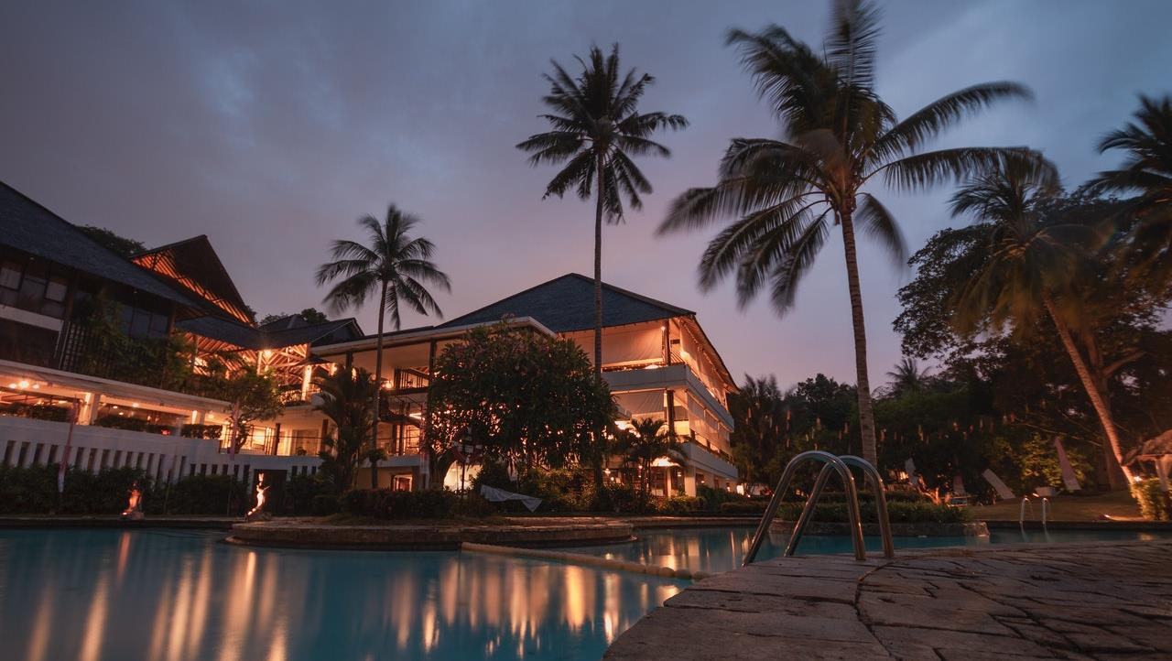
Predicting Hotel Booking Cancellations
Factors influencing hotel booking cancellations
Team Finch
27th May, 2023

Slide 2
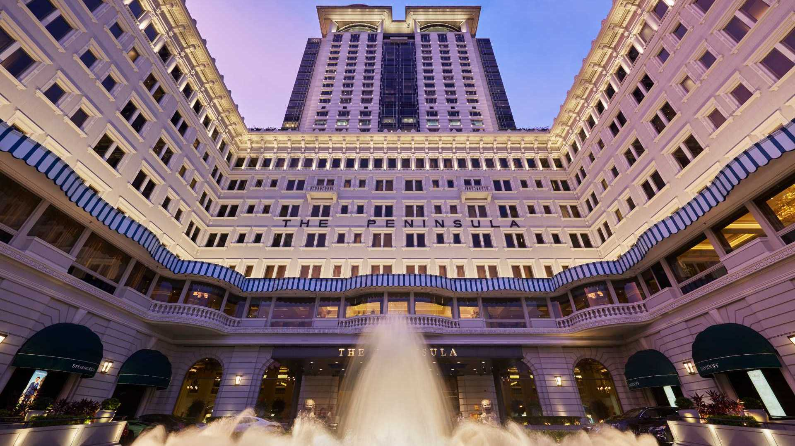
Agenda
Background
Business Problem
Data Overview
Methodology
Exploratory Data Analysis
Recommendations

Slide 3
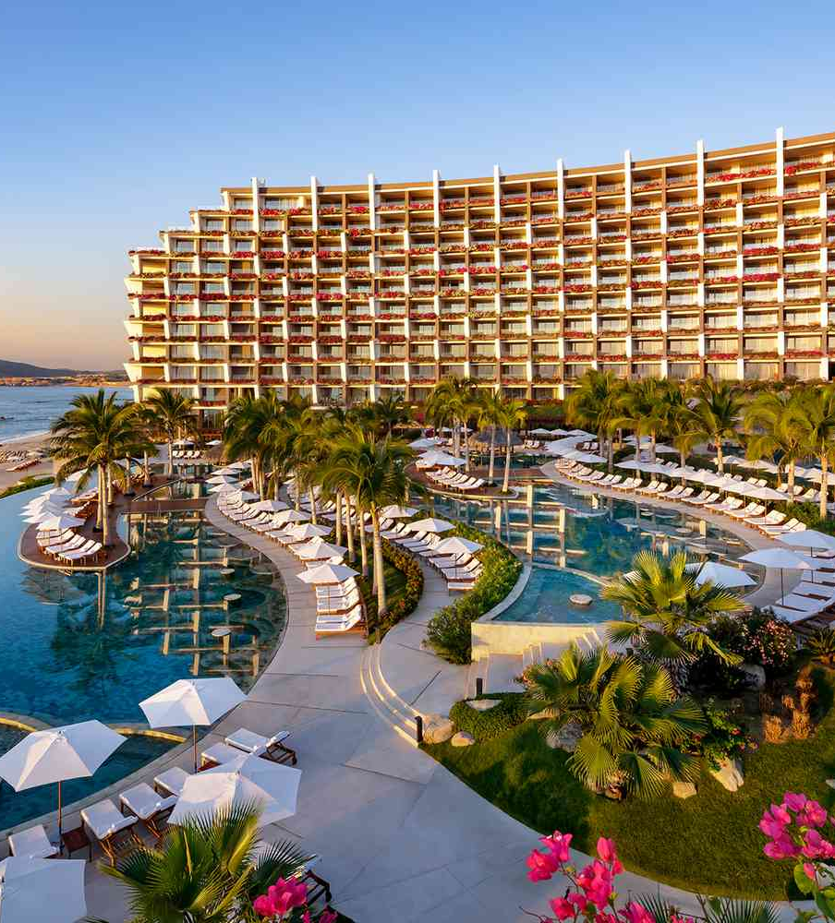
Background
Hotel industry is vital, diverse, and continuously evolving
Unpredictable global travel trends have exacerbated the challenge of managing booking cancellations
Leveraging hotel booking data to predict cancellations
Enhances efficiency, guest satisfaction and profitability

Slide 4

Business Problem
Hotel industry experiences demand from frequent business travellers and leisure tourists. Our objective is to utilize hotel booking data to forecast potential cancellations
We aim to address the following business inquiries:
Would a customer cancel the booking?
What are the primary factors influencing hotel booking cancellations?

Slide 5

Data overview
Label:
Dummy variable: Is_Cancelled
Predicators:
Guest nationality, hotel amenities, market segment, customer type, etc.
Data source: Kaggle - Hotel booking demand datasets
Types: Resort and City Hotel
119,391 rows and 32 features
1st July 2015 – 31st August 2017

Slide 6




Methodology
Exploratory Data Analysis
Data Preprocessing
Data Modeling

Slide 7

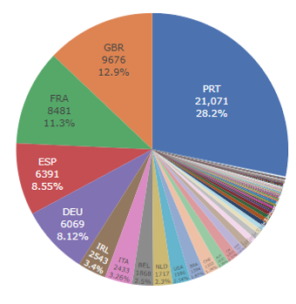
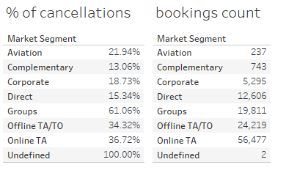



Exploratory Data Analysis
Notes:
We visualized data to determine whether each feature could potentially influence the cancellation rate.
Firstly, the pie chart illustrates that most visitors are from Europe, namely Portugal, UK and France.
The second bar chart show the cancellation rate by market segments and hotels. There are high rates of cancellations at both Resort and City hotels. Compared to the Resort Hotel, the City Hotel has a higher cancellation rate.
The bottom table presents the cancellation rate is lowest for the Complementary segment and reaches highest from the Groups segment at 61%.
the top market segment is the online travel agent(OTA) and the least is from the Aviation segment.

Slide 8
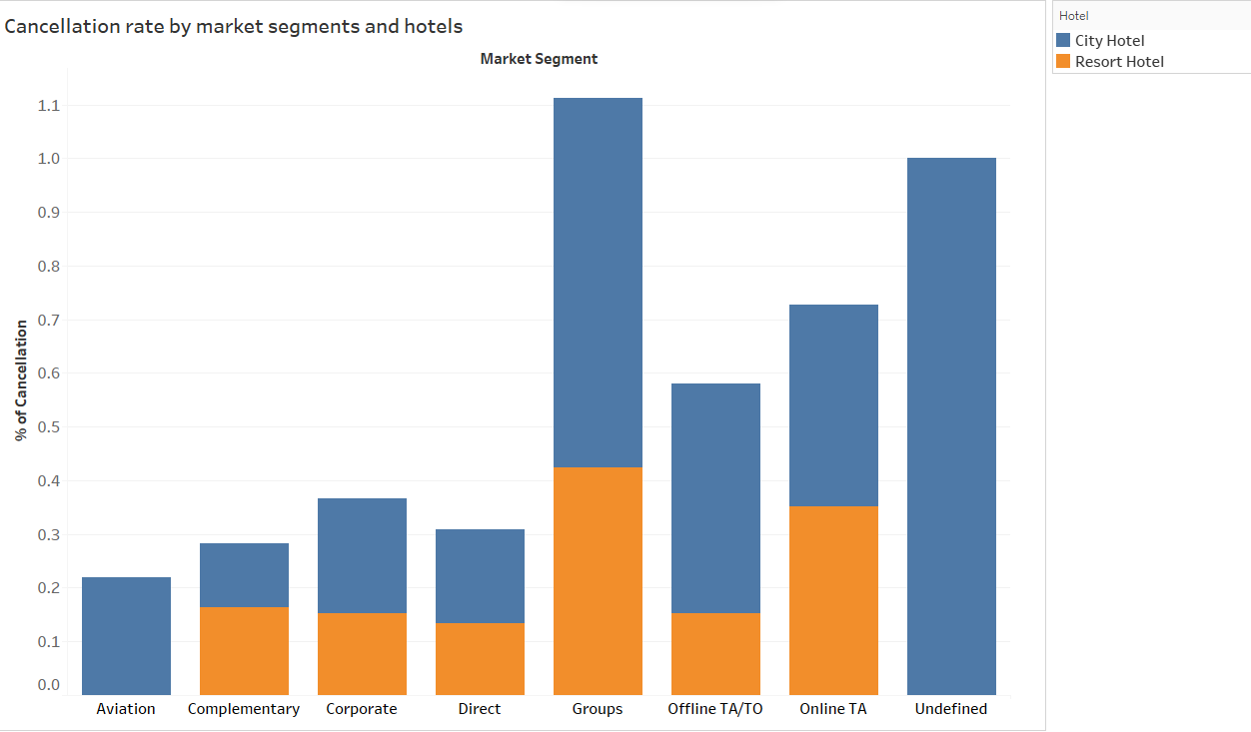
Exploratory Data Analysis

Slide 9
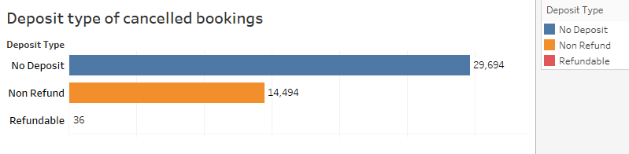
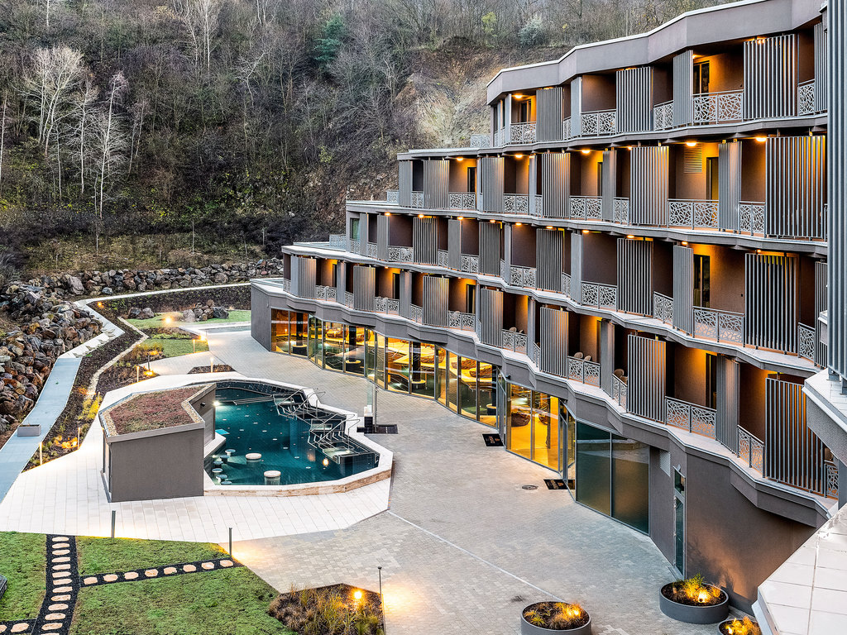
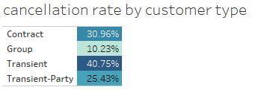
Exploratory Data Analysis
Notes:
From the deposit type of cancelled booking bar chart, we can see the majority of the canceled reservations did not require a deposit.
The top right table shows cancellation rate by different customer types and transient customers account for the highest cancellation rate while the group guests have the lowest.
Looking at the monthly cancellation rate line chart , it presents city hotels have more cancellation rates compared to resort hotels in all months. It is noted that the cancellation rate of city hotels is almost equal to other months even in winter. While the cancellation rate in winter months is low for resort hotels.

Slide 10
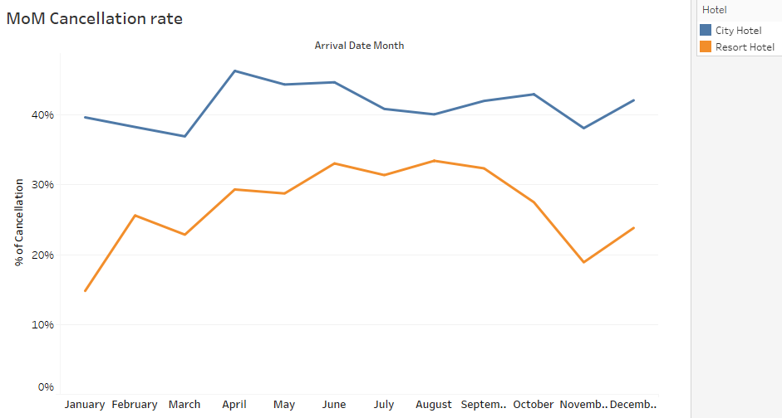
Exploratory Data Analysis

Slide 11
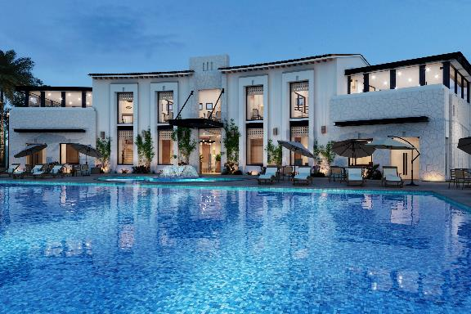

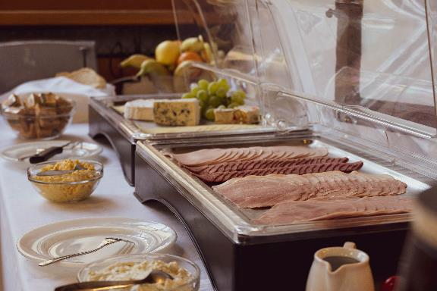
Data Preprocessing
Conduct 3 – steps data cleaning process:
1. Handle missing values
2. Correlation analysis
3. Feature Engineering &
Label Encoding

Slide 12

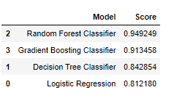
Model Building
Model Selecion
Logistic Regression
Random Forest
Decision Tree
Gradient Boosting
RF ROC: 0.985

Slide 13
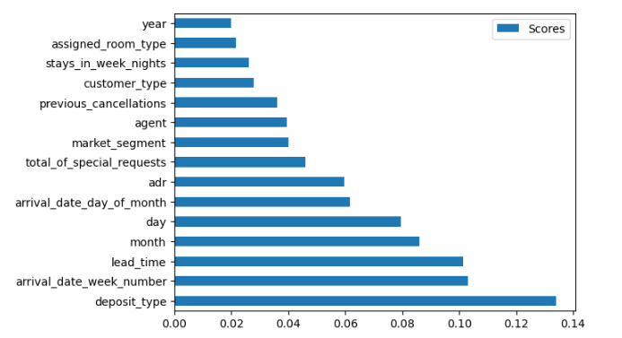
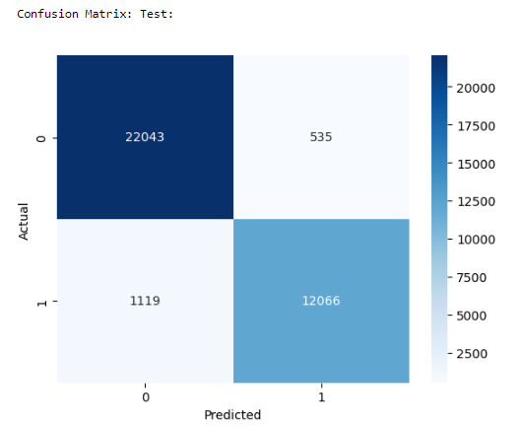
Best Model Results
Notes:
It is evident that the Random Forest model achieved the highest accuracy score( around 95%) and highest Precision, Recall and F1-Score.
On the other hand, the Logistic Regression had the lowest score
From the confusion matric of the best model, we can find: Out of the total observations, 1119 were wrongly classified as non-canceled when they were actually canceled, while 535 observations were incorrectly labeled as canceled when they were not.
The variables that had a significant impact on the model are: deposit_type, arrival_date_week_number, lead_time, month, adr, total_of_special_requests, etc.

Slide 14
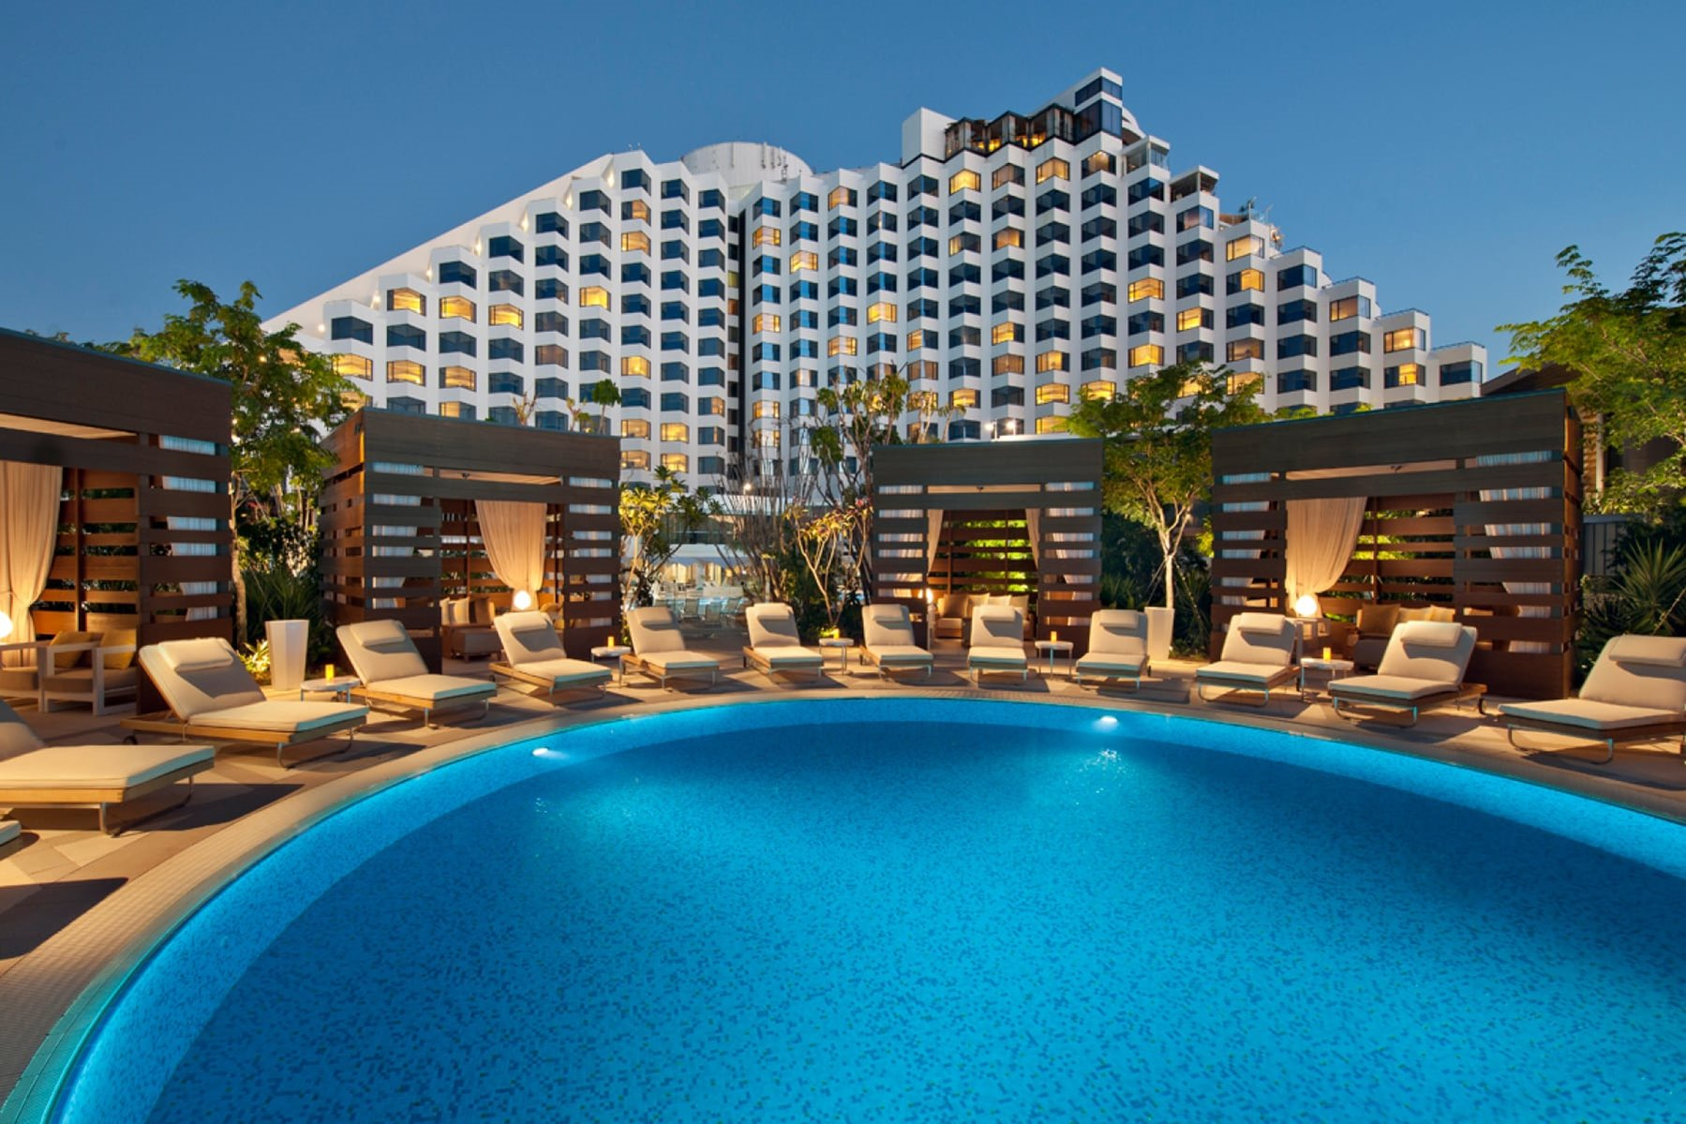
Recommendations
Predict daily cancellations using a Random Forest model for a strategic overbooking approach.
Enhance bookings by exploiting the positive correlation between special requests and fewer cancellations.
Curb cancellations by revising the policy to include deposits and setting up a cancellation feedback system.
Tap into Online Travel Agents' and Tour Operators' markets through tailored promotions.
Evaluate booking influencers via an in-depth feature importance analysis.
Update model and policies for effective cancellation management amid global events like COVID-19.
Notes:
Using Random Forest model for daily cancellation predictions, informing an optimal overbooking strategy considering capacity and booking regulations.
Capitalize on the correlation between fewer cancellations and more special requests to enhance guest satisfaction and booking commitments.
Consider a revised cancellation policy incorporating deposit requirements to reduce cancellations and implement a feedback mechanism to understand cancellation reasons.
Leverage the potential of Online Travel Agents and Tour Operators' market segments through targeted promotions.
Conduct a thorough analysis of feature importance, considering ranks within each feature group for a comprehensive understanding of influential factors.
In the face of significant global events like the COVID-19 pandemic, adapting our predictive model with new data, including post-event changes, is critical; we recommend complementing this with flexible booking options to mitigate cancellation risks and enhance customer trust and loyalty.

Slide 15
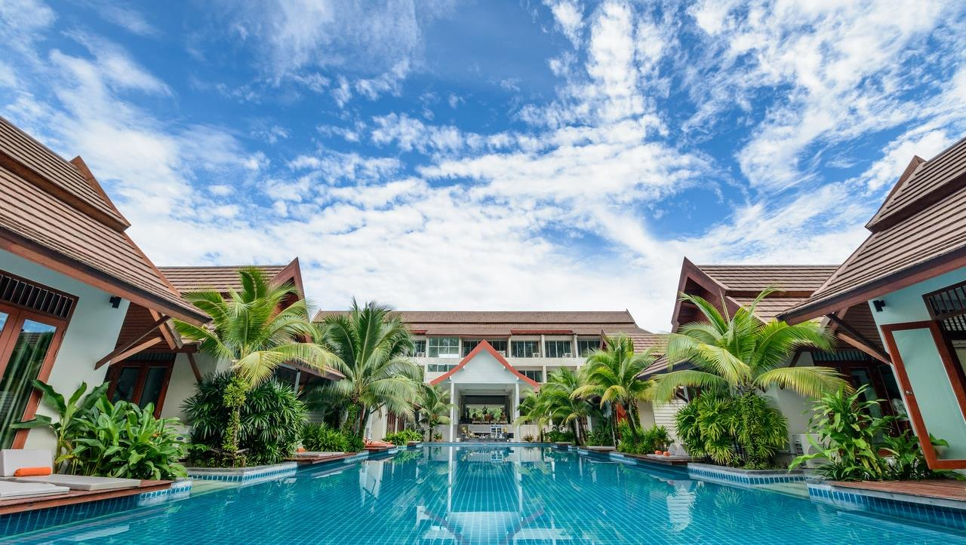
THANK YOU

Slide 16
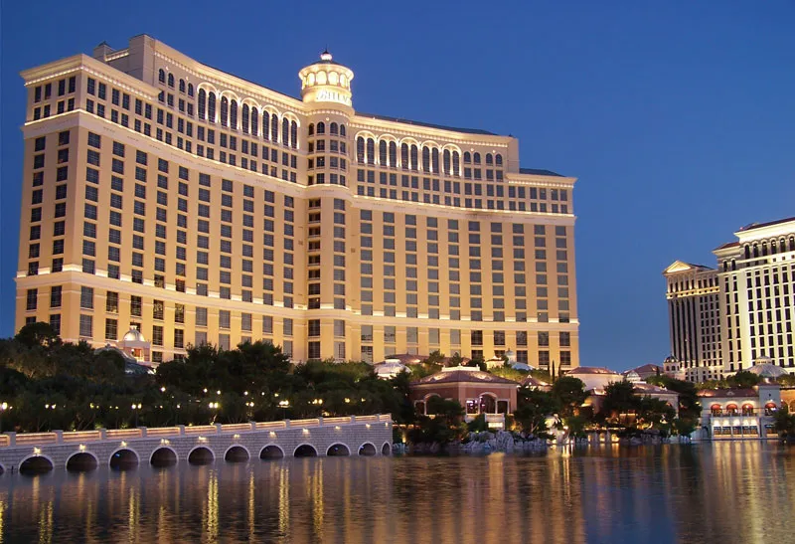
Q & A

